Slide 1
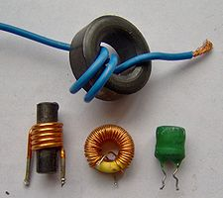
Section 12: Inductance

Slide 2
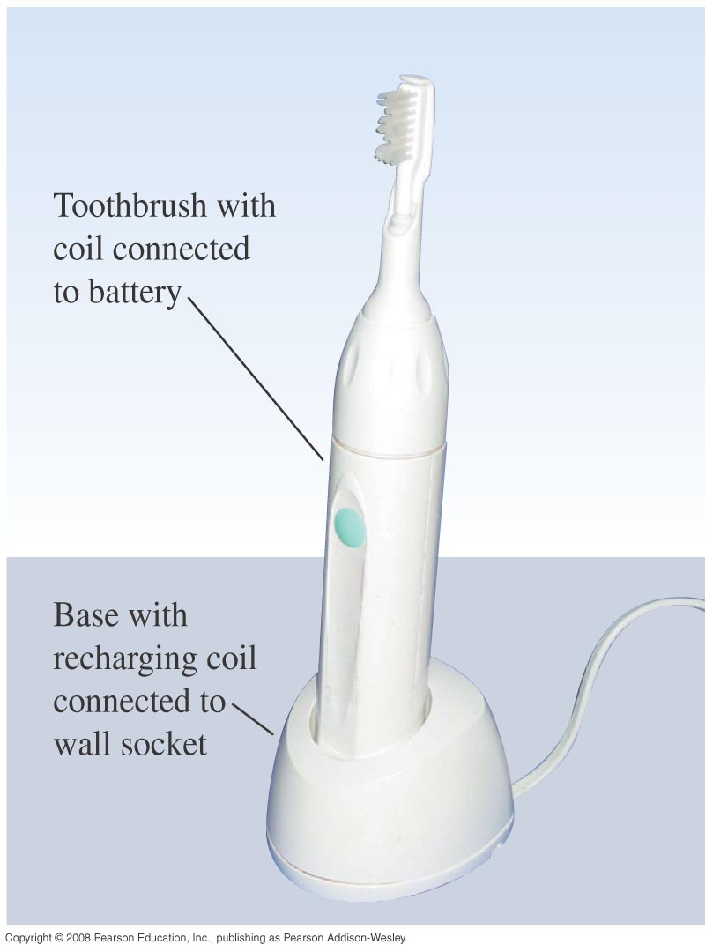
Activity: Mutual Inductance

Slide 3
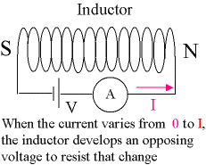
Self-Inductance

Slide 4
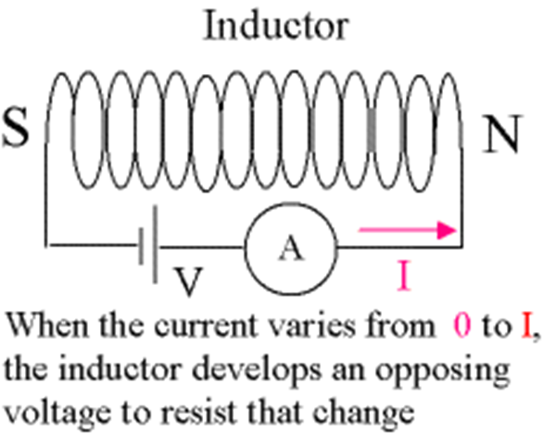

Self-Inductance
$$ε=−L\frac{di(t)}{dt}$$

Slide 5
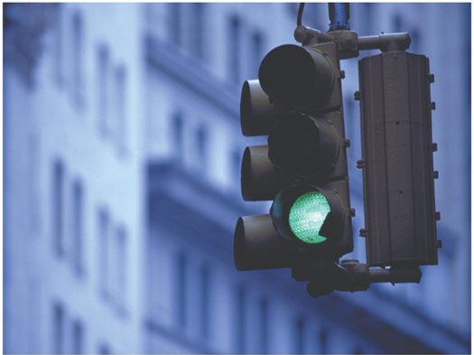
Self-Inductance
Ferromagnet → Increased Inductance!
Application: Traffic light sensors!

Slide 6
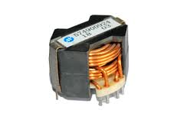

Energy Stored in an Inductor
$$U=\frac{1}{2}Li^{2}$$

Slide 7
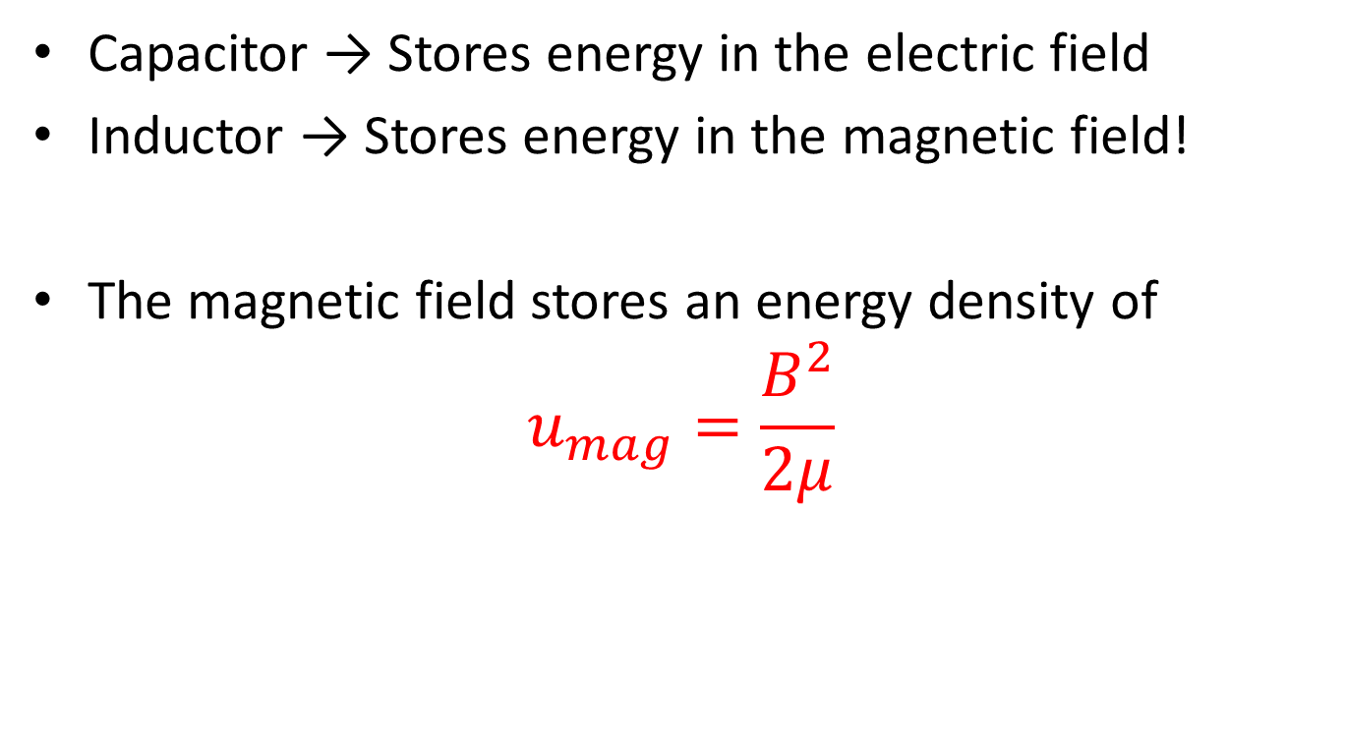
Magnetic Field Energy
Capacitor → Stores energy in the electric field
Inductor → Stores energy in the magnetic field!
The magnetic field stores an energy density of
$$u_{mag}=\frac{B^{2}}{2μ}$$

Slide 8
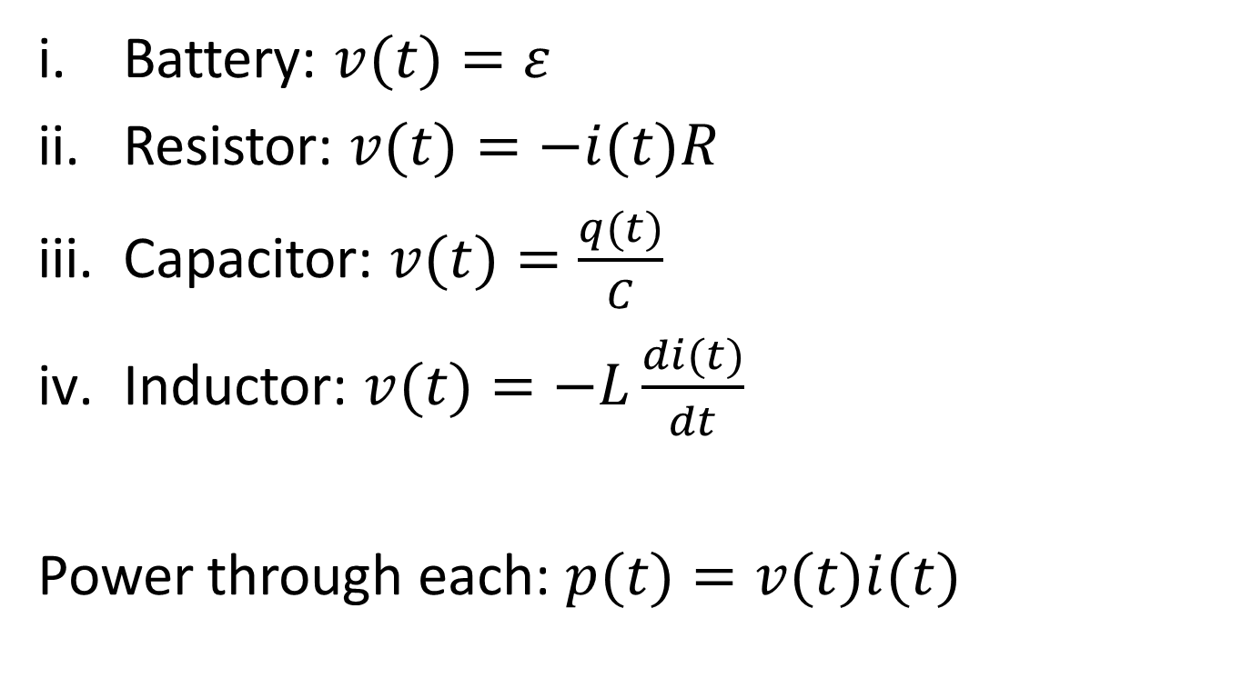
Voltage in Circuits: Summary
Battery: $v(t)=ε$
Resistor: $v(t)=−i(t)R$
Capacitor: $v(t)=\frac{q(t)}{C}$
Inductor: $v(t)=−L\frac{di(t)}{dt}$
Power through each: $p(t)=v(t)i(t)$

Slide 9
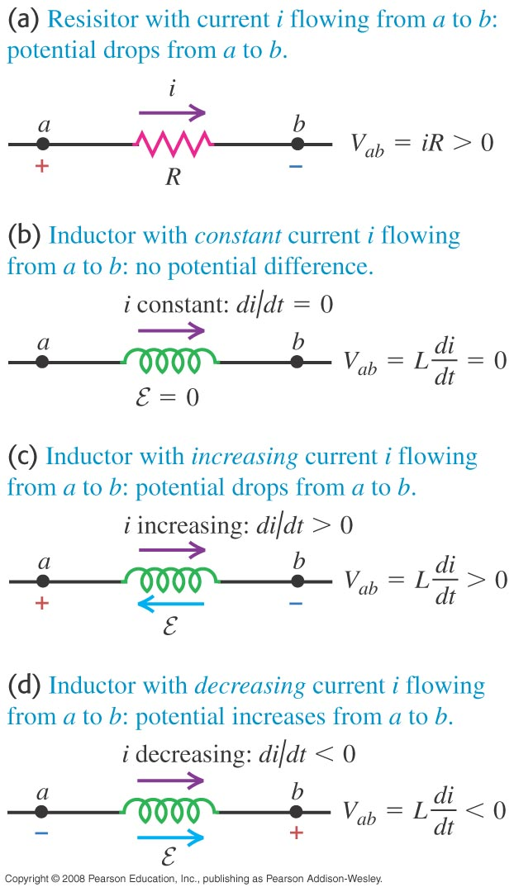
Inductors in Circuits: Direction of EMF

Slide 10
Inductors in Circuits
What circuits can we build??
An R circuit (done in Sections 7, 8)
An R-C circuit (done in Section 8)
An R-L circuit
An L-C circuit
An R-L-C circuit

Slide 11
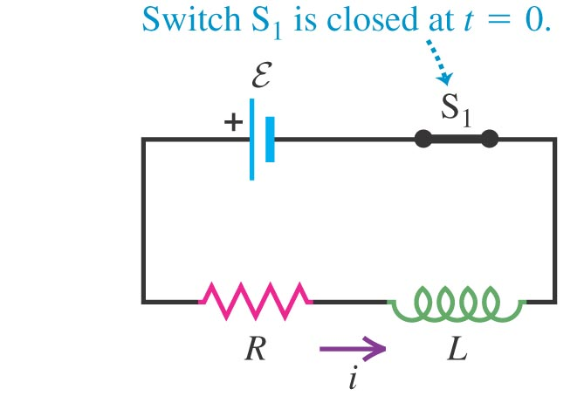
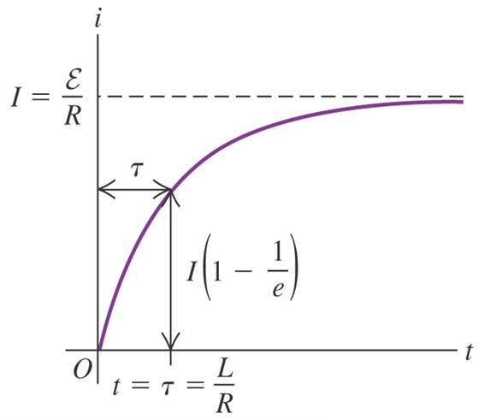
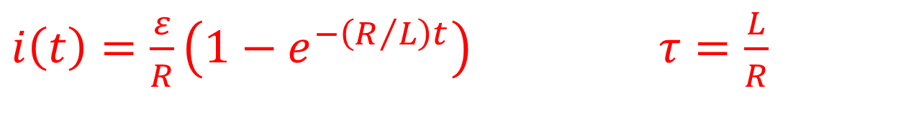
Current Growth in the R-L Circuit
$i\left(t\right)=\frac{ε}{R}\left(1−e^{−\left(R/L\right)t}\right)$ $τ=\frac{L}{R}$

Slide 12
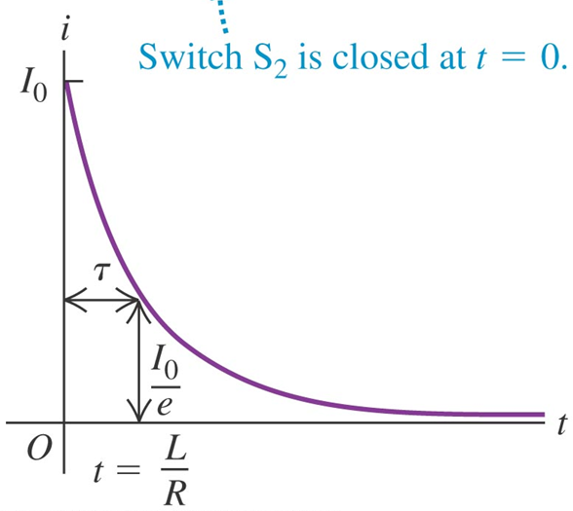
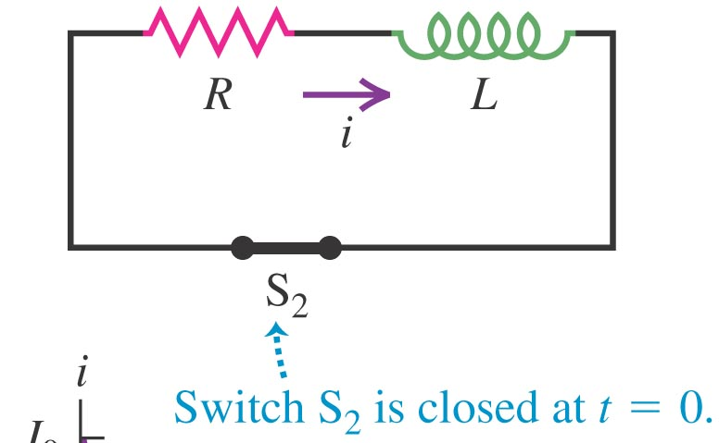
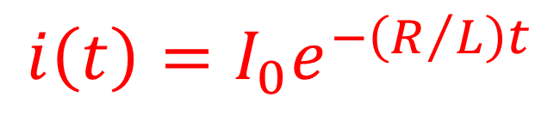
Current Decay in the R-L Circuit
$$i\left(t\right)=I_{0}e^{−\left(R/L\right)t}$$

Slide 13
Activity: The RL Circuit

Slide 14
Example: RL Circuit

Slide 15
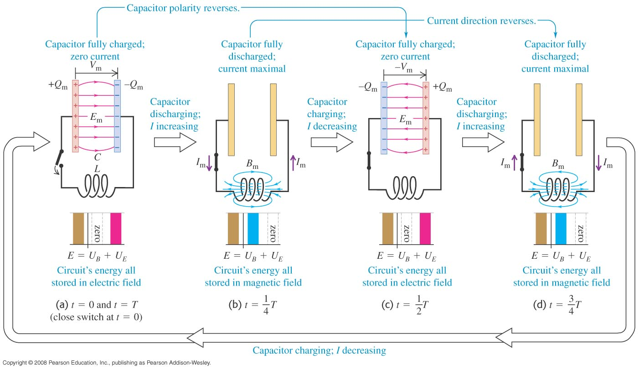
The L-C circuit
New behavior → Oscillating current and charge!

Slide 16

The L-C Circuit
$$q(t) = Q\cos\left(ωt+φ\right)$$
with $ω=\sqrt{\frac{1}{LC}}$

Slide 17
Activity: The LC Circuit

Slide 18
Example: LC Circuit

Slide 19
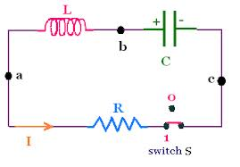
The L-R-C Circuit
Add a resistor
What happens??

Slide 20
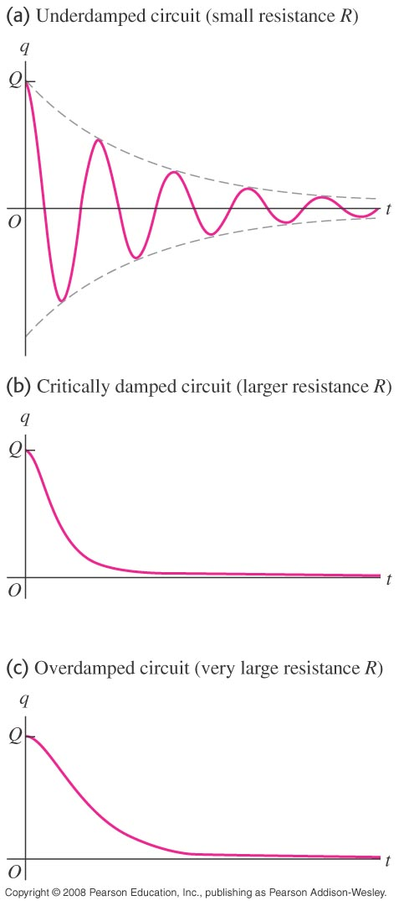
The L-R-C Circuit

